Slide 1
أكـــــاديميــــة طــــويـــق
Scalable Data Science

Slide 2
cuDF: Understsanding performance and visualization
Analyzing Performance by profiling utilities
By: Dr. Afshan Hashmi

Slide 3
Course Objectives:
To introduce the fundamentals of cudf.pandas and its role in accelerating data processing using GPUs.
To equip learners with profiling techniques for optimizing performance and identifying GPU vs. CPU execution in data workflows.
To explore data visualization techniques using third-party libraries like Plotly with cudf.pandas.

Slide 4

Numba: Just-In-Time (JIT) Compilation for Speeding Up Python Code
Numba is a Python library that accelerates code execution using JIT compilation.
Converts Python code into machine code at runtime for improved performance.
It is particularly useful for speeding up numerical computations without requiring extensive rewrites of Python code.
Numba works well with NumPy, allowing array operations to be executed much faster.
Key Features:
Easy to use with minimal code changes.
Supports CPU and GPU acceleration.
Compatible with NumPy, SciPy, and other Python libraries.

Slide 5
Why Use Numba?
Benefits:
Speed: Dramatically improves performance of numerical computations.
Simplicity: Requires only a decorator to optimize functions.
Flexibility: Works with existing Python code and libraries.
Use Cases:
Scientific computing.
Data analysis.
Machine learning and deep learning.
Speed
Simplicity
Flexibility

Slide 6

How JIT Compilation Works
JIT Compilation Explained
Traditional Python code is interpreted line-by-line, causing slower execution.
Numba compiles functions into machine code just before execution, leading to significant speedups.
Uses LLVM (Low-Level Virtual Machine) for optimizing execution.

Slide 7
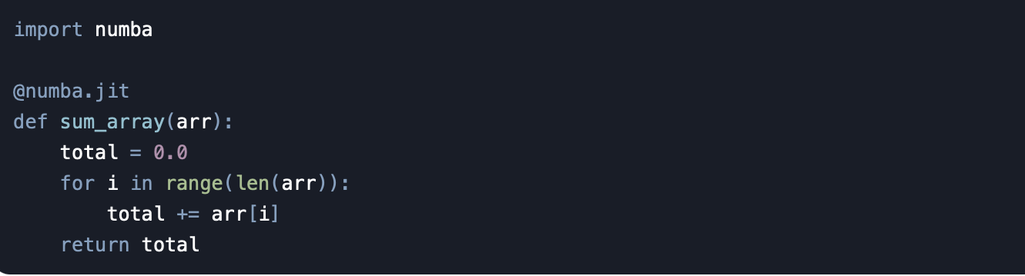
How Numba Works
Steps:
Decorate a Python function with @numba.jit.
Numba compiles the function to machine code at runtime.
Executes the optimized code for faster performance.

Slide 8

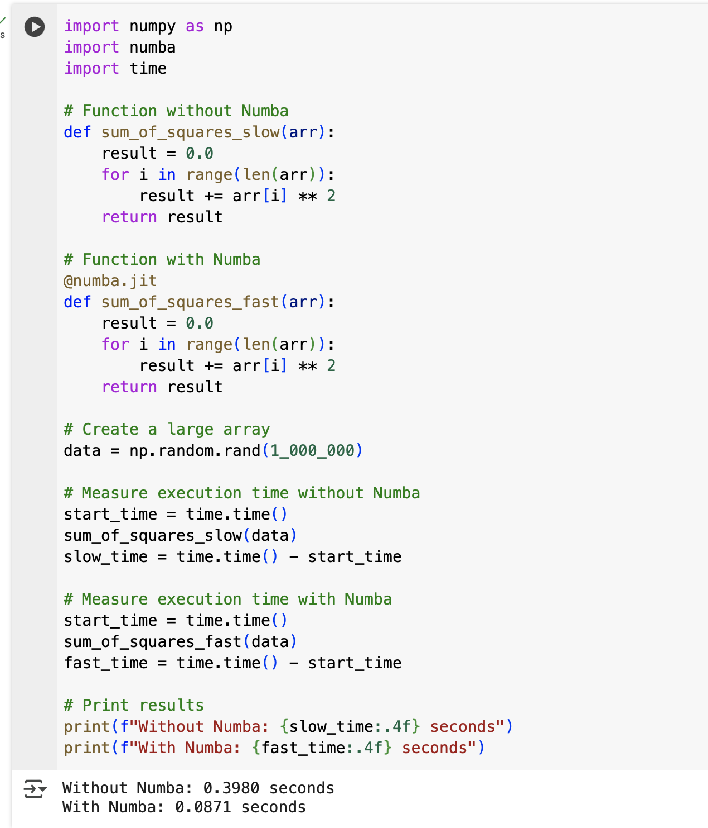
Performance with & without numba
Without Numba: The function runs in pure Python, which is slower due to interpreter overhead.
With Numba: The function is compiled to machine code, resulting in significantly faster execution.

Slide 9
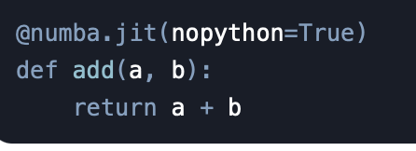
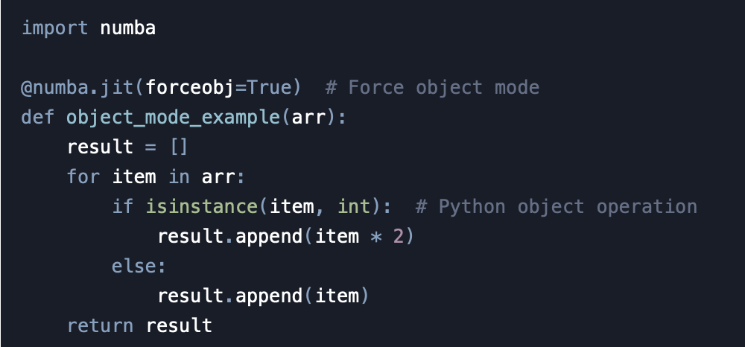
Numba Modes
1. nopython Mode:
Ensures the function is fully compiled to machine code.
No Python objects are allowed.
Example:
2. object Mode:
Allows Python objects but is slower.
Used as a fallback when no python mode fails.

Slide 10

Limitations of Numba
Challenges:
Works best with numerical computations.
Limited support for non-NumPy Python features.
Requires careful handling of data types.
When Not to Use:
For non-numerical or highly dynamic Python code.

Slide 11
Summary
Numba accelerates Python code using JIT compilation.
Works best with loops and numerical computations.
NumPy operations are highly optimized with Numba.
Simple to use: Just add @jit(nopython=True) decorator.
Helps in high-performance computing, scientific computing, and machine learning workloads.

Slide 12

Practical Implementation
Click on the link below to go to Google COLAB
https://colab.research.google.com/drive/10_sbDJlV6zeSHAnHY_EWTf9t488Vn0Hz#scrollTo=210h8e44YxPQ

Slide 13

















الشراكات العالمية

Slide 14
شــــــكــــرًا لكــــــم
THANK YOU

